Slide 1
Deep Neural Network and Sequence Models.pptx
HE Huifan
NEC Laboratories Singapore

Slide 2
Syllabus
Neural Networks Overview
Recursive Neural Network (RNN)
Long Short-term Memory (LSTM)

Slide 3
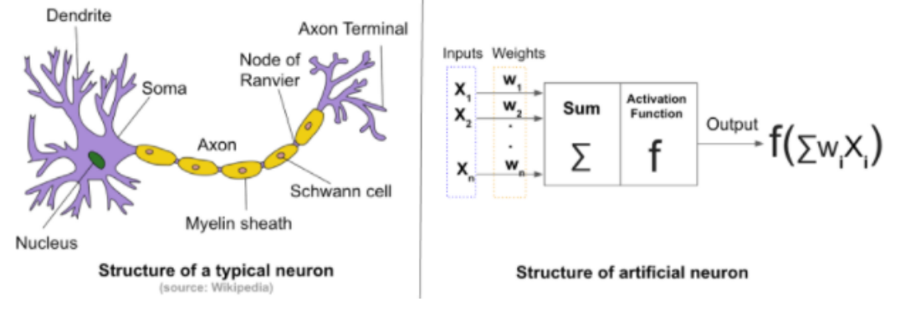
Overall Induction of Neural Networks
Artificial neural networks (ANN) or connectionist systems are computing systems vaguely inspired by the biological neural networks that constitute animal brains.
An ANN is based on a collection of connected units or nodes called artificial neurons, which loosely model the neurons in a biological brain. Each connection, like the synapses in a biological brain, can transmit a signal from one artificial neuron to another. An artificial neuron that receives a signal can process it and then signal additional artificial neurons connected to it. https://en.wikipedia.org/wiki/Artificial_neural_network

Slide 4
Overall Induction of Neural Networks
Deep Learning (Deep Neural Network) is a class of machine learning algorithms that:
use a cascade of multiple layers of nonlinear processing units for auto feature extraction and transformation. Each successive layer uses the output from the previous layer as input.
learn in supervised (e.g., classification) and/or unsupervised (e.g., pattern analysis) manners.
learn multiple levels of representations that correspond to different levels of abstraction; the levels form a hierarchy of concepts.
Traditional ML
Algorithm:
Input
Manual Feature Extraction
Weight Learning
Result Prediction
Deep Learning
Algorithm:
Input
Auto Multi Layer Feature Extraction
Weight Learning
Result Prediction
Layer 1:
Lines
Layer 3:
Simple Shapes
Layer 3:
Complex Shapes

Slide 5
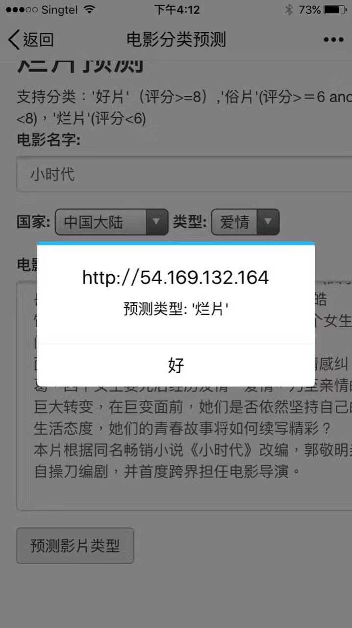

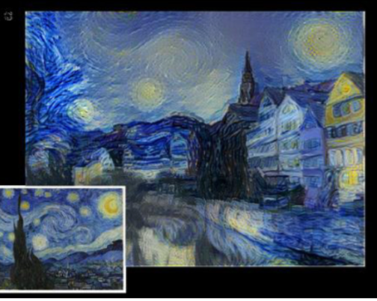
Neural Networks Use Cases

Slide 6
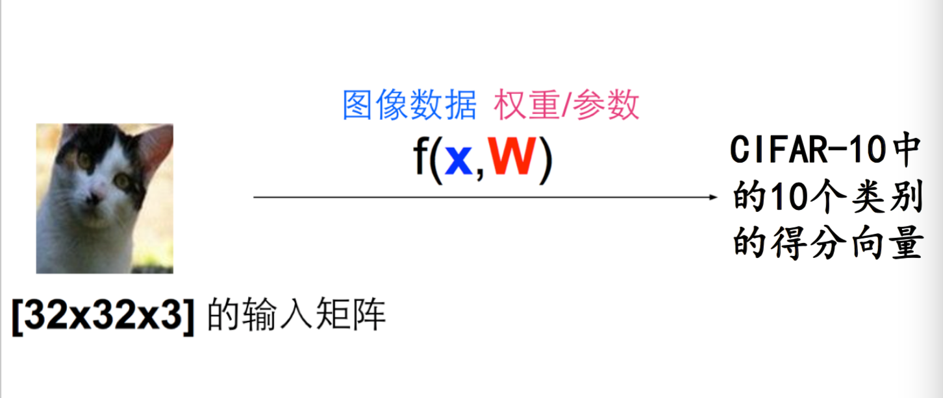
Example: Linear Classifier
Input Matrix —> (Flatten) 3072 *1
—>Transpose 1* 3072
Weight Matrix: 3072 * 10
1 * 10 Score
Matrix for 10
Categories

Slide 7
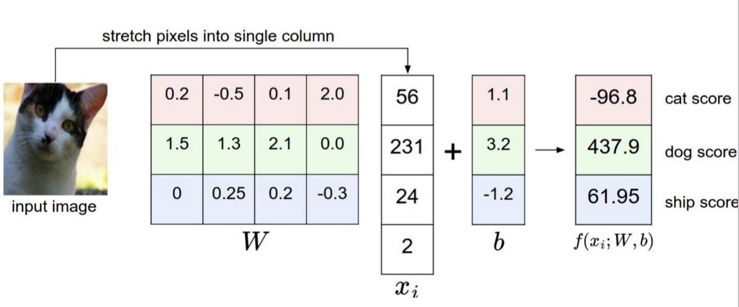
Example: Linear Classifier

Slide 8
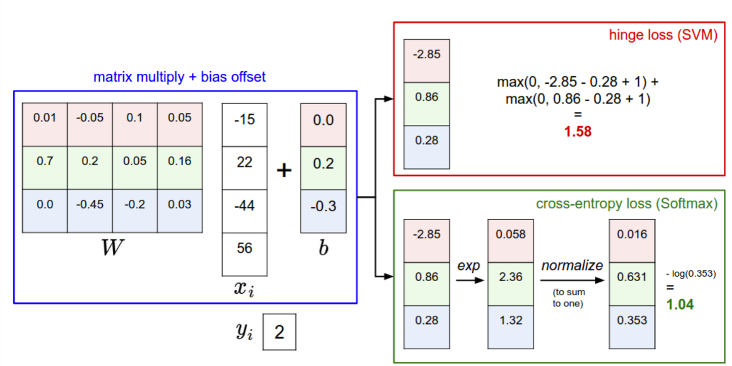
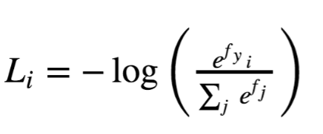
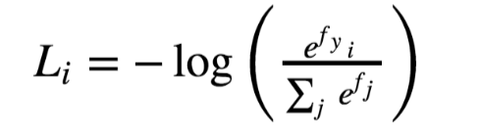
Example: Calculate Loss
Real Output Probabilities: [0,0,1]
Li = - Log(pi)

Slide 9
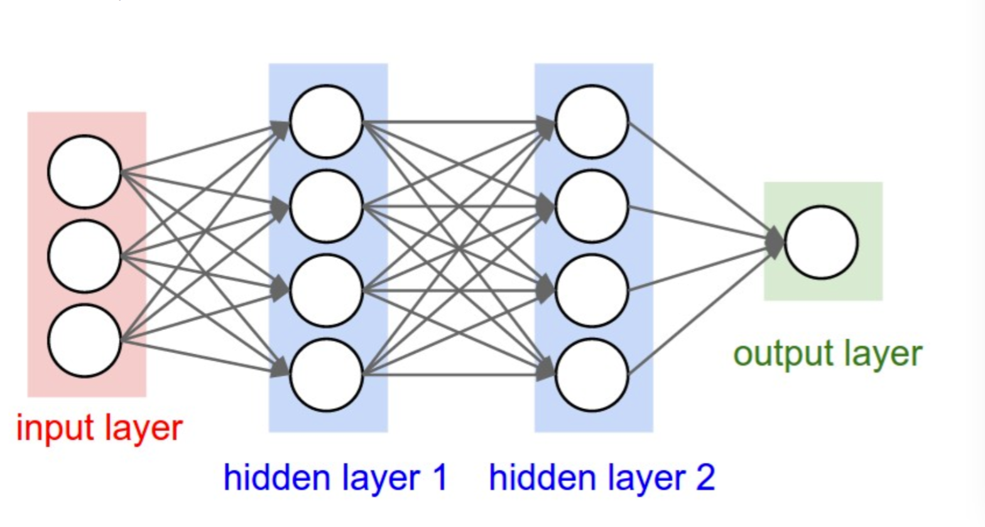
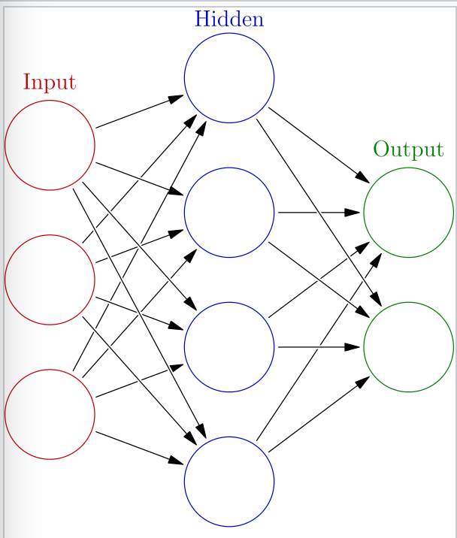
The Structure of Neural Networks
Forward Propagation:The input X provides the initial information that then propagates to the hidden units at each layer and finally produce the output. The architecture of the network entails determining its depth, width, and activation functions used on each layer.
Calculate Loss: Measure the difference between the predicted output and real output. (Cross-Entropy, MSE, etc)
Backward Propagation: Allows the information to go back from the cost backward through the network in order to compute the gradient using SGD.

Slide 10
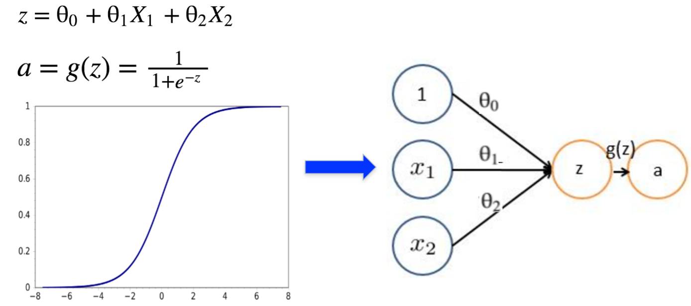
From Logistic Regression to Perception
(Activation function:
Sigmoid)

Slide 11
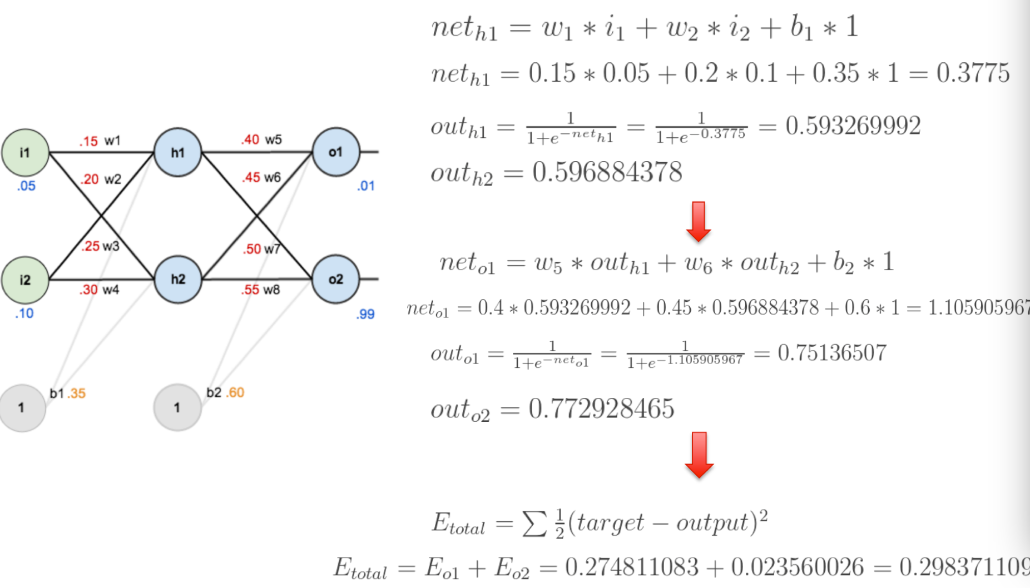
Example: Forward Propagation and Loss Calculation
Forward Propagation:
Loss Calculation:

Slide 12
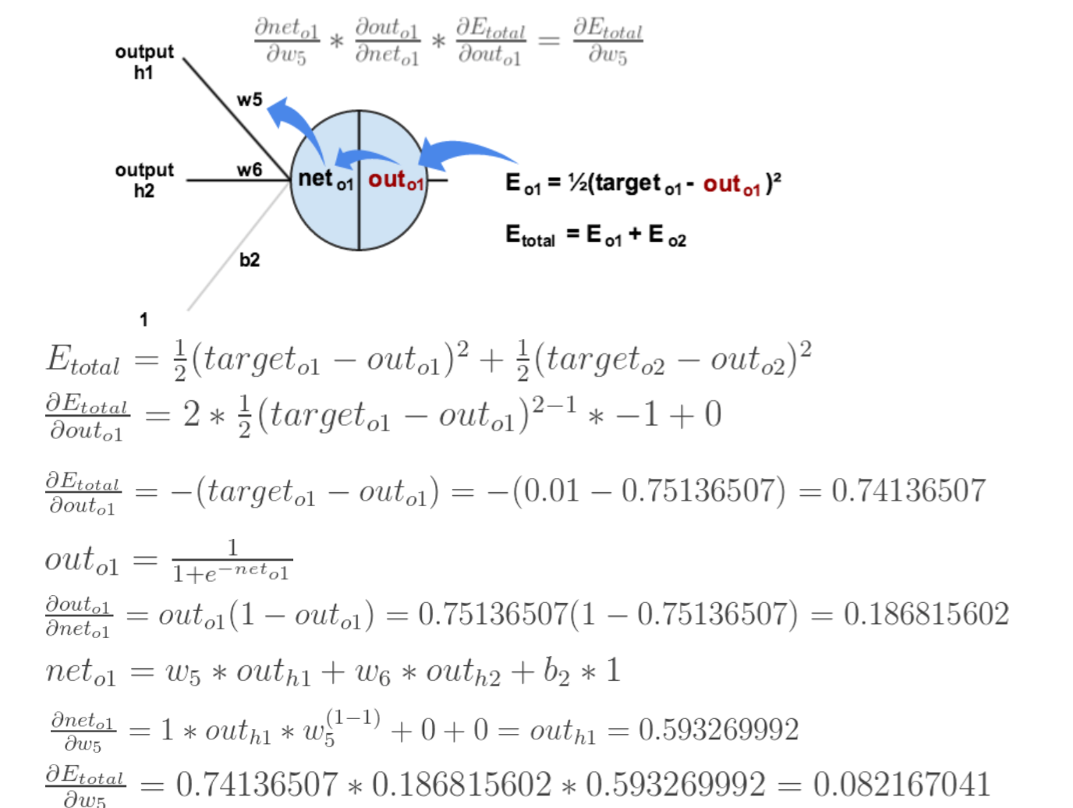
Example: Backward Propagation to Calculate Gradient
Chain derivation：l’ * g’ * f’ = l(g(f(x)))’

Slide 13
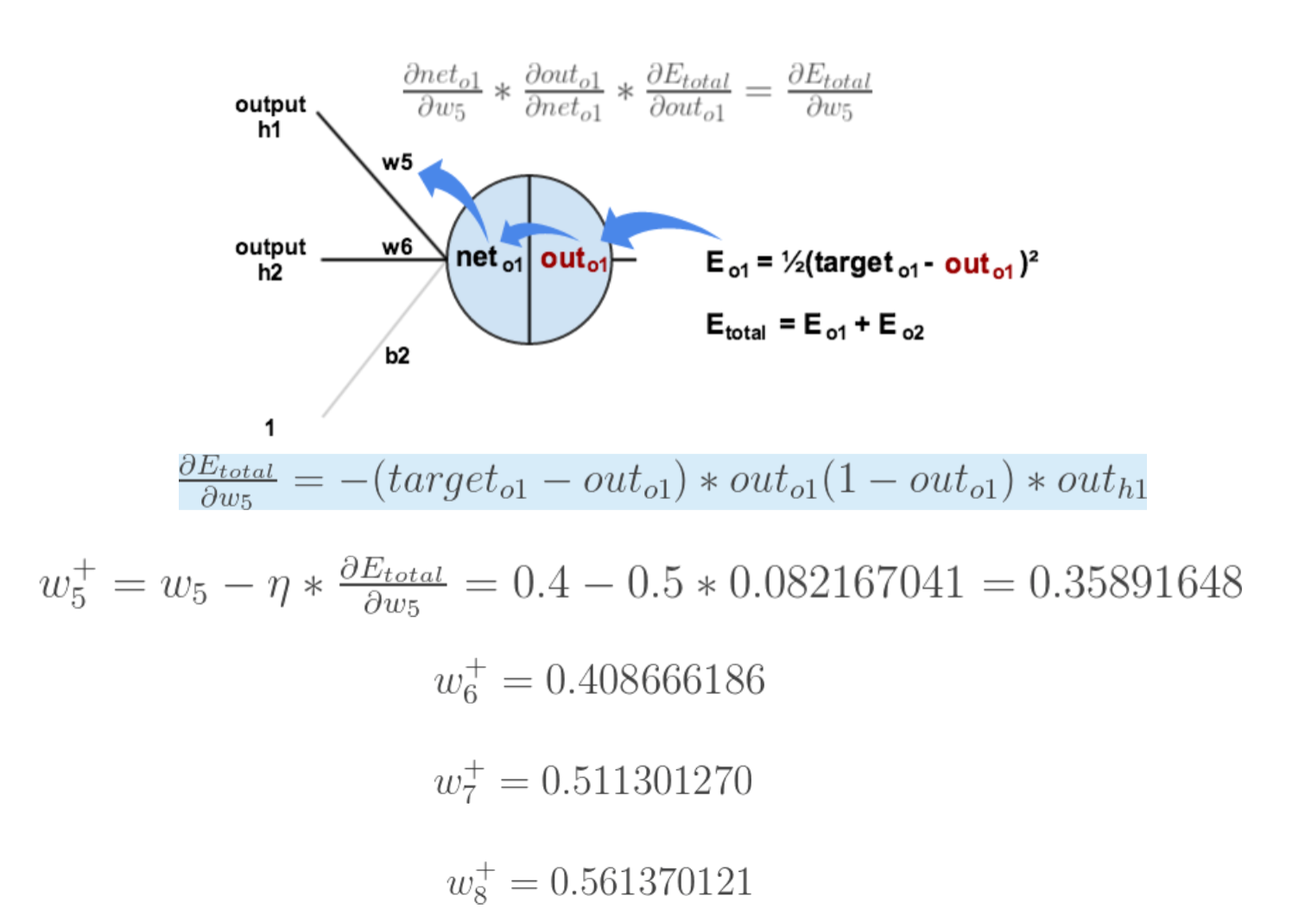
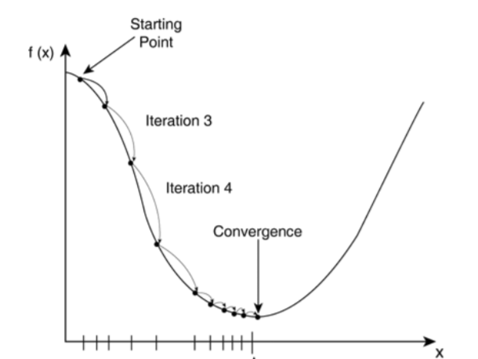
Example: Backward Propagation and Weight Update

Slide 14
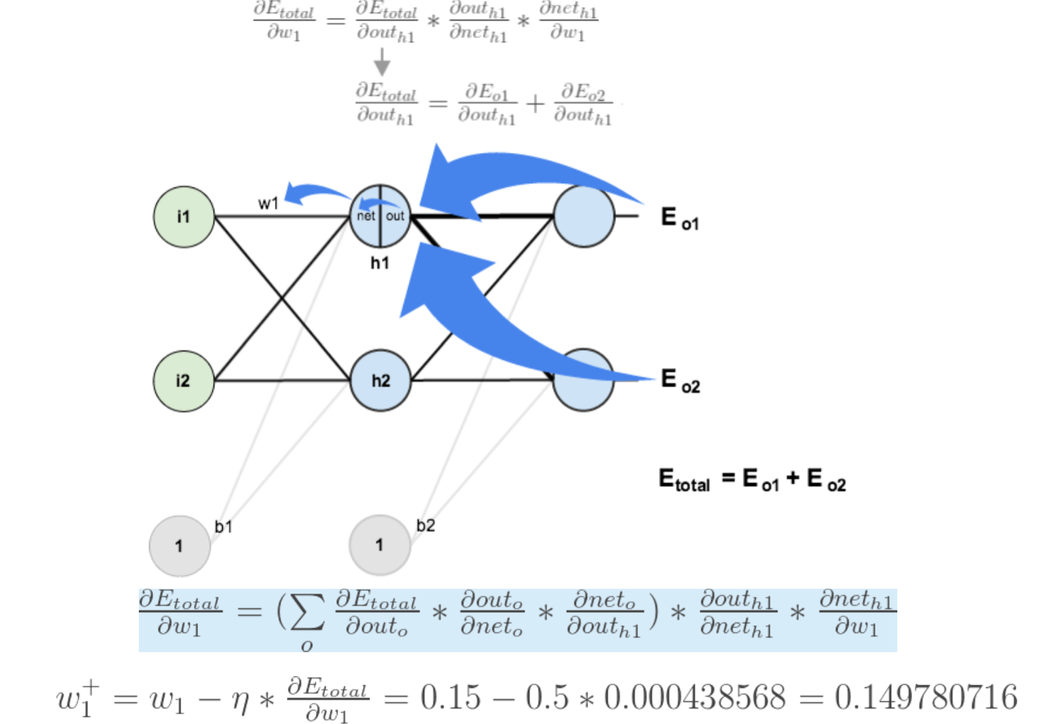
Example: Backward Propagation and Weight Update

Slide 15
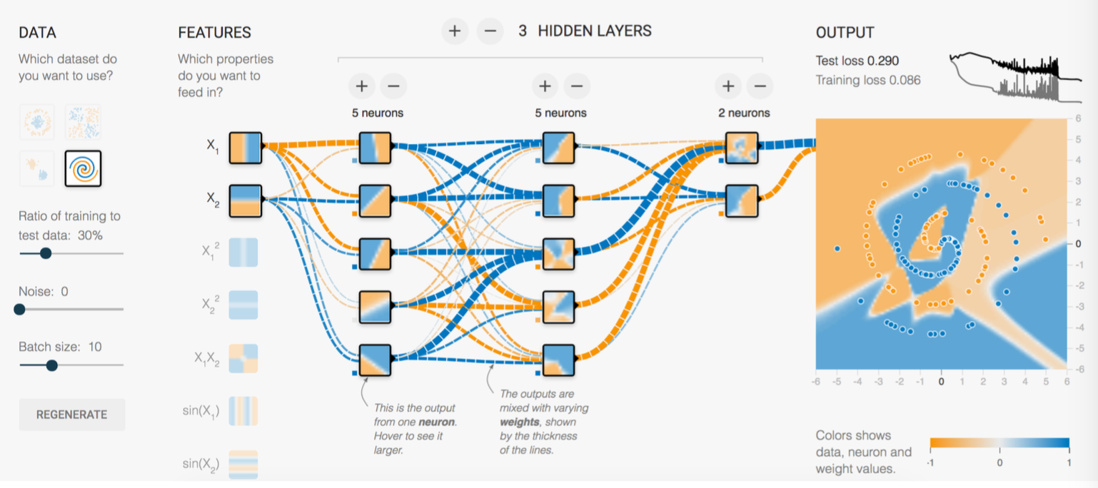
Neural Networks Non-Linear Classification
https://playground.tensorflow.org

Slide 16
Sequence Model: RNN Overview
Why we need Recursive Neural Network(RNN) since we already have DNN?
The input and output is independent using DNN. For some task, there is correlation between input sequence. e.g. I am from China, my native language is chinese.
Recursive: Every unit does the same task.
Memory: The output depends on both current input and memory.

Slide 17
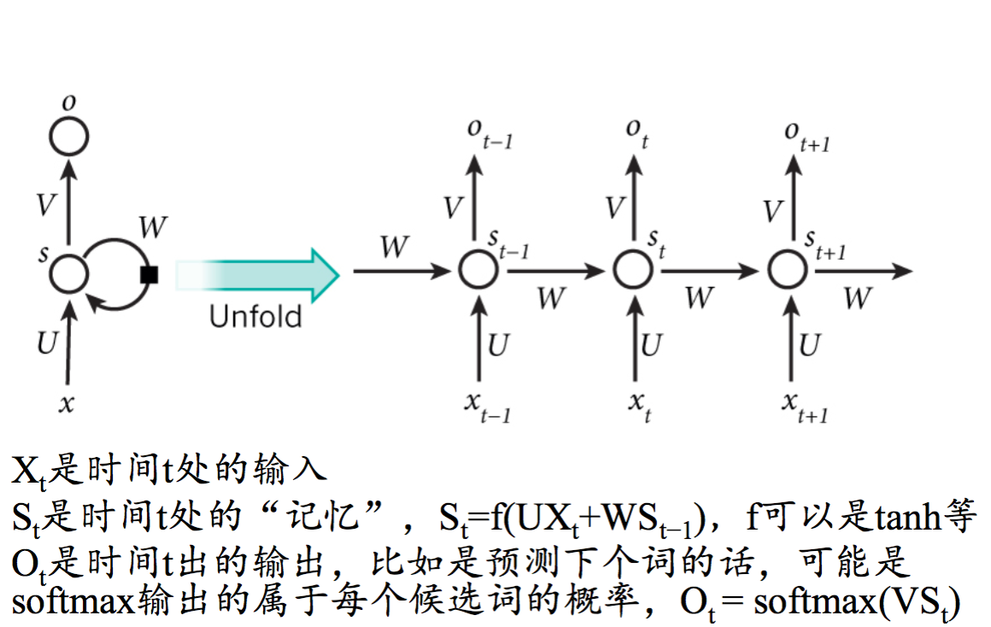
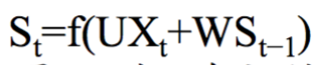
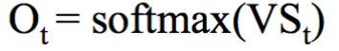
Sequence Model: RNN Structure
like
reading
I
like
reading
Xt: the input of current t. (e.g. each word of a sentence)
St: the memory of current t. f could be Tanh, etc.
Ot: the memory of current t. It could be the predicted probability for next the candidate word.

Slide 18
Sequence Model: RNN Structure
S is invisible status that captures the information of previous sequence.
Output is a combination of the current input and previous information.
Unfortunately, not all the previous information can be captured. (Limited Memory?)
Each unit of RNN share the same set of parameters (U, V, W)
Output is not mandatory for every unit. (e.g. Text Sentiment Classification only requires the final output of the last unit.

Slide 19
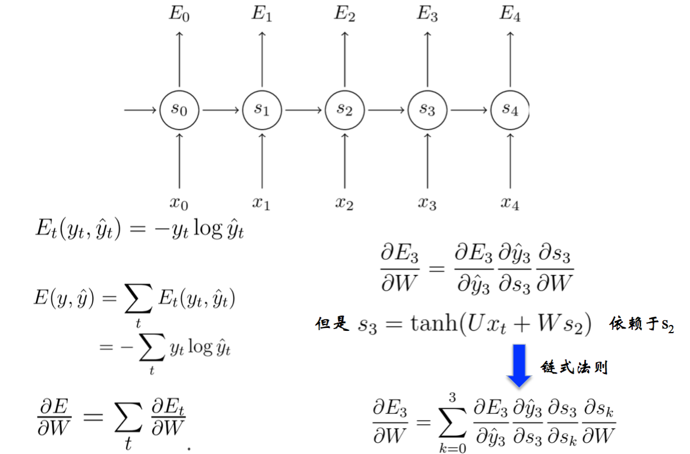
Sequence Model: RNN and BPTT
like
listening
to
Britpop
I
like
listening
to
Britpop
Chain Rule

Slide 20
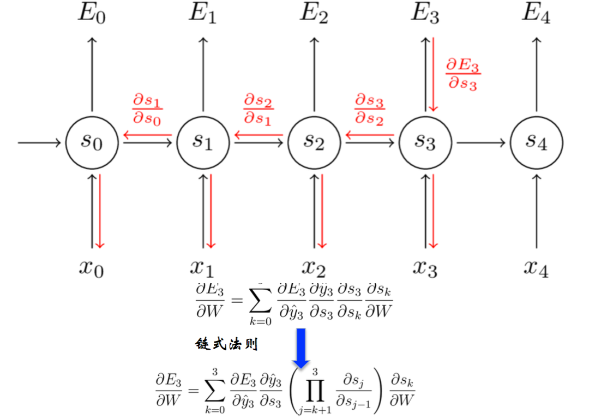
Sequence Model:RNN and BPTT
Chain Rule

Slide 21
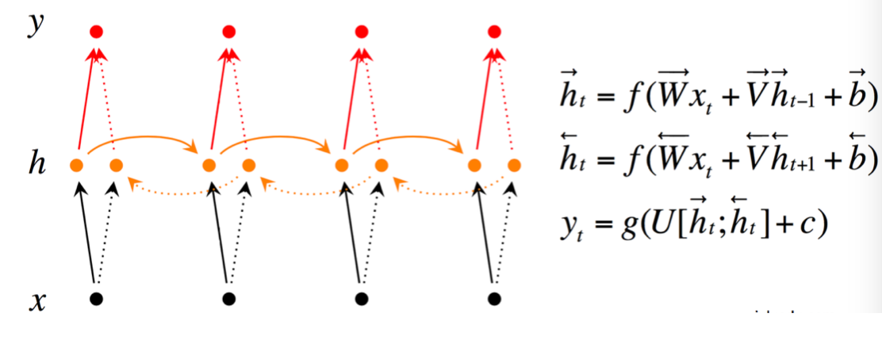
Sequence Model:Bi-direct RNN
Bi-direct RNN: The output not only depends on the previous sequence but also the folllowings.

Slide 22
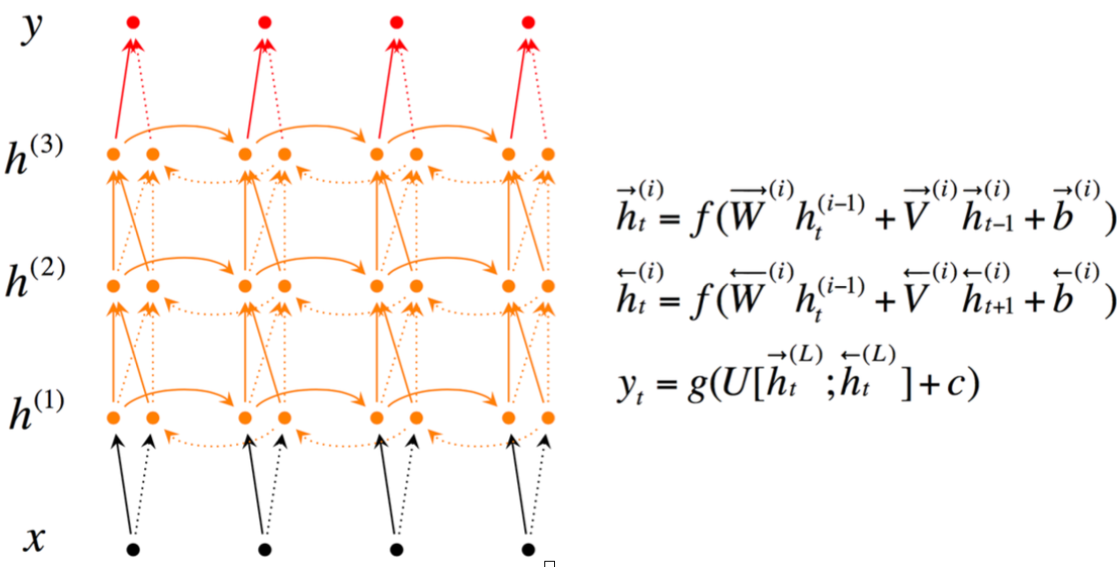
Sequence Model:Deep Bi-direct RNN
Deep Bi-direct RNN: Multi-layer Bi-direct RNN

Slide 23
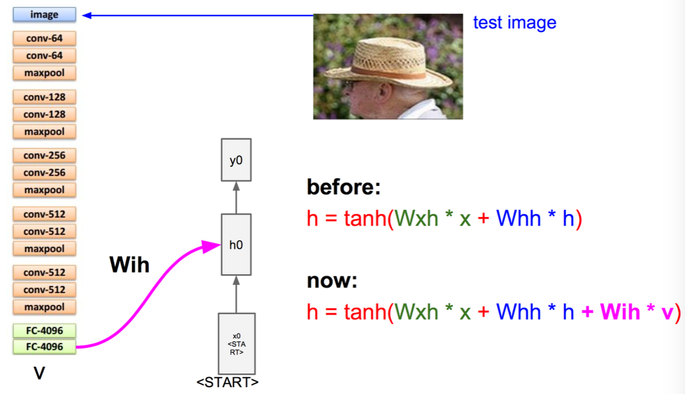
Sequence Model:Image to Text Use Case
Fix AlexNet

Slide 24
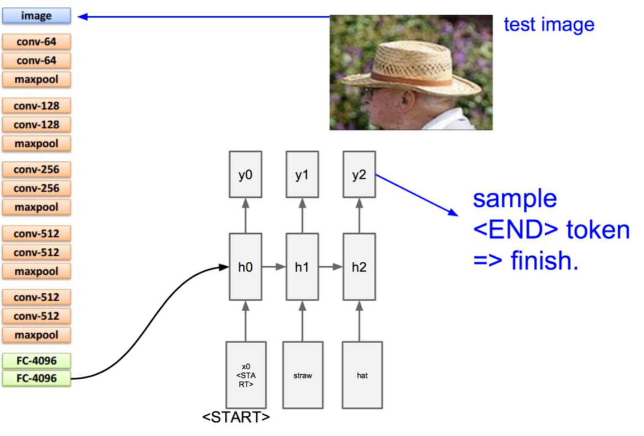
Sequence Model:Image to Text Use Case
Man
in
hat

Slide 25
Sequence Model: LSTM
RNN is a solution to integrate the previous memory with the current input.
However, there is Short Term Memory Issue for RNN. Specifically, RNN is not able to capture the memory that is far from the current time.
Solution: Long Short Term Memory (LSTM)
St = fff(St-3) if any of f’ = 0 then fff’ = 0

Slide 26
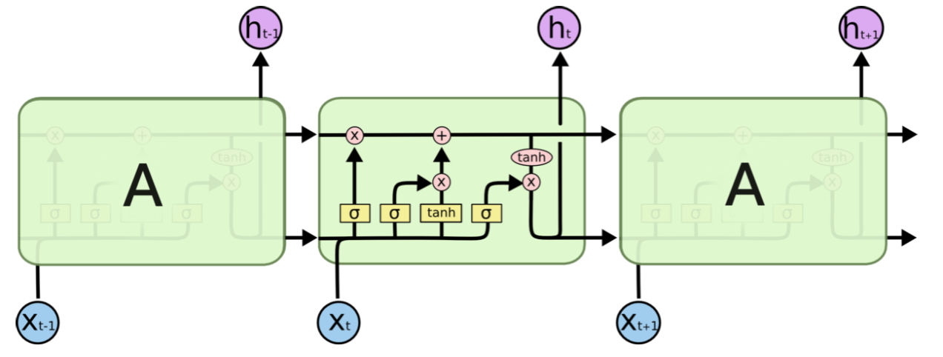
Sequence Model: LSTM
LSTM is one type of RNN with similar structure.
Difference: The Cell of LSTM has been transformed with Gates. The useful information will be continuously passed on that will not be blocked by the Gate.

Slide 27
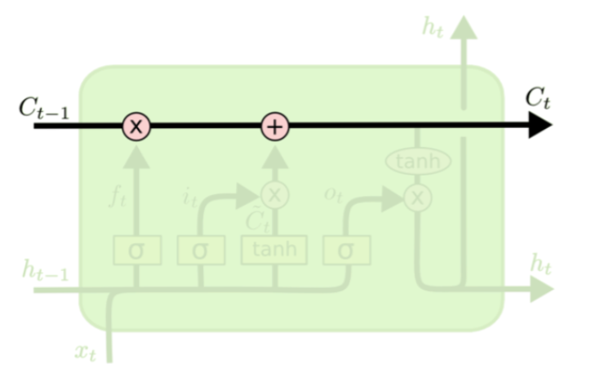
Sequence Model: LSTM
Key of LSTM: Cell State. Information is passed on through a conveyer belt like chain with limited linear interaction, which make it possible to stay the same.

Slide 28
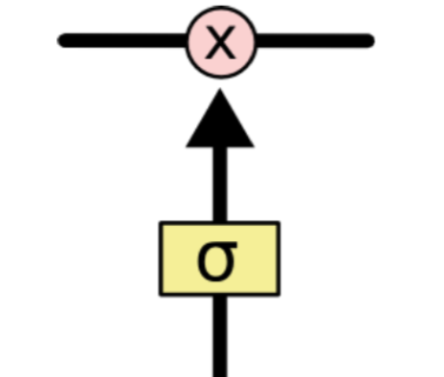
Sequence Model: LSTM
How to control cell state in LSTM
Uses gates to select, eliminate or update information to call state with sigmoid and point wise operation
The range of sigmoid output is from 0 to 1 (Block/Pass)

Slide 29
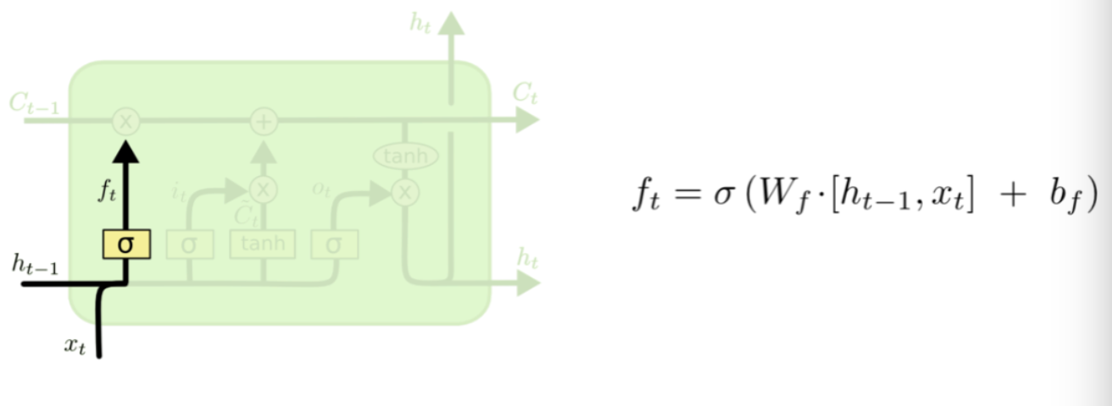
Sequence Model: LSTM Gates
Step 1: Forget Gate: Determine which part/the percentage of previous output should be remained in cell status. e.g. ‘ The the air used to be fresh here. However, it has been polluted.
Sigmoid: 0~1

Slide 30
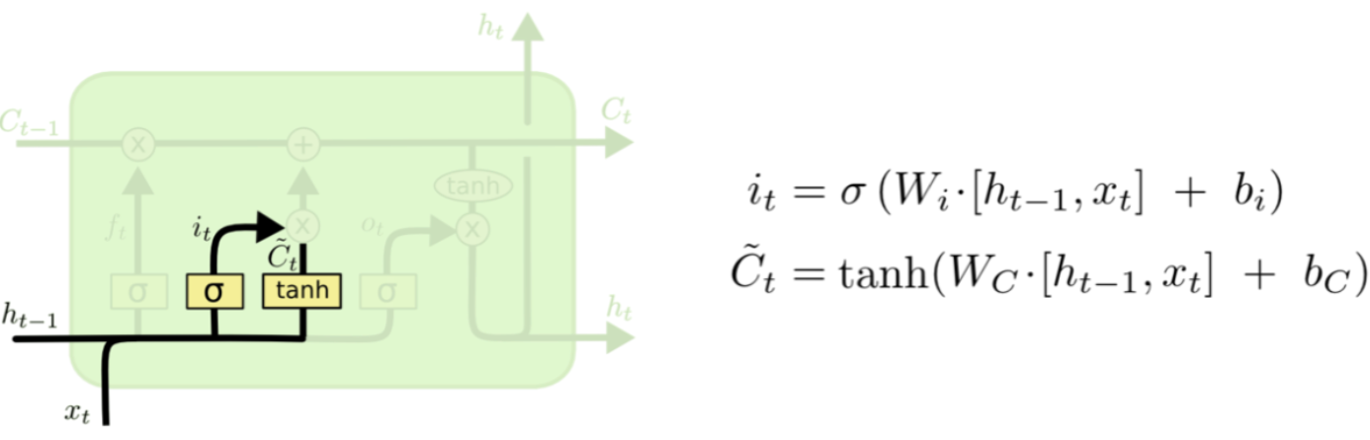
Sequence Model: LSTM Gates
Step 2: Input Gate: Determine what new information should be input into cell status. Sigmoid will determine which part of candidate C need to be updated while Tanh will create candidate C.
Percentage (Probability)
New information

Slide 31
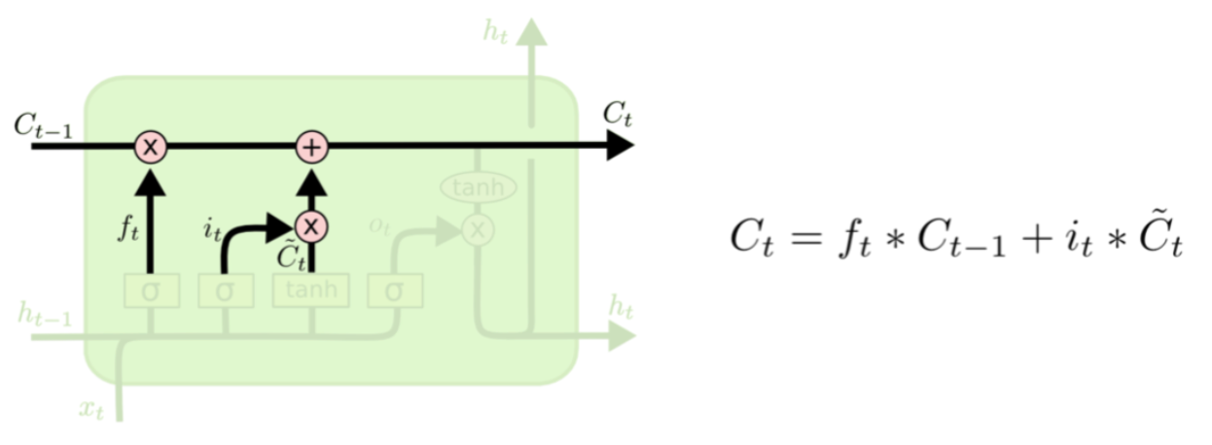
Sequence Model: LSTM Gates
Step 3: Update Cell State Ct.
The old information should be kept: Ft * Old Cell State
Newly updated information: it *~Ct
Sigmoid: 0~1
Sigmoid: 0~1
multiplication —> addition
so no gradient vanish

Slide 32
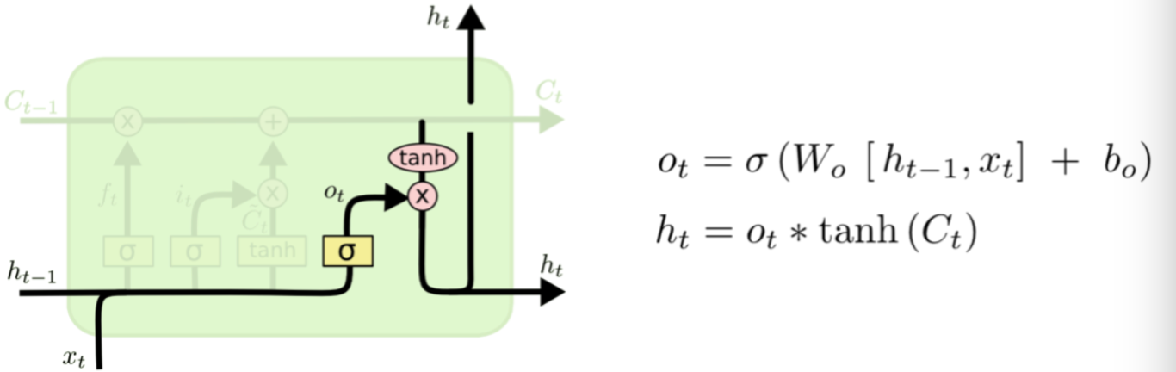
Sequence Model: LSTM Gates
Step 4: Output based on Cell State.
Sigmoid determines which part of cell state will be in output
Tanh(Ct) * Sigmoid determines the final output
Sigmoid: 0~1

Slide 33
RNN/LSTM Use Cases
Name Entity Recognition
Text Classification
Machine Translation
Image to Text

